Slide 1

To detect OS, sessions and open ports through packet sniffing
By Himanshu Dixit (11904892)
Roll no- 51

Slide 2

WHAT IS PACKET SNIFFING
process of intercepting/analyzing traffic in order to obtain information transmitted on network
used for a variety of purposes, like network troubleshooting, security auditing.
can also be used for malicious purposes, such as stealing passwords or sensitive data
can only intercept unencrypted data packets, as it is typically unreadable to a packet sniffer.
use encryption protocols such as HTTPS or SSL/TLS

Slide 3

What is network minor tool
NetworkMiner is a free network forensic analysis tool that is used to capture and analyze network traffic. users can capture traffic in real-time or import previously captured traffic from PCAP files. The tool then analyzes the traffic to extract various pieces of information, such as the source and destination IP addresses, port numbers, and protocols.
NetworkMiner can also extract files from network traffic, including images, documents, and other types of data. This feature makes it a useful tool for investigating security incidents and analyzing network activity.

Slide 4
WHERE TO USE?
Network monitoring: monitor network activity and identify potential issues like suspicious traffic patterns or unauthorized access attempts. to monitor network performance and identify issue that may affect network performance.
Network forensics: to analyze network traffic and identify potential security incidents/attack for ex. malware infections and investigate the cause of network issues or outages.
Incident response: respond to security incidents by analyzing network traffic to identify the source of an attack and the data that was stolen or compromised.
Malware analysis: identify malware infections, as well as to extract malware samples for further analysis.

Slide 5

How it work ?
Capture network traffic:
Analyze packet data:
Display data in a user-friendly format:
Extract files from network traffic:
Further analysis and investigation:

Slide 6
Other tools
Wireshark
tshark
Nmap
Snort
Zeek

Slide 7

Target system description
Here the target system considers to do this project are 2 machines, they are-
• First one is host window the software is running on i.e., my laptop
• Second one is the host from the Trojan infected window machine in traffic analysis prebuild PCA file

Slide 8
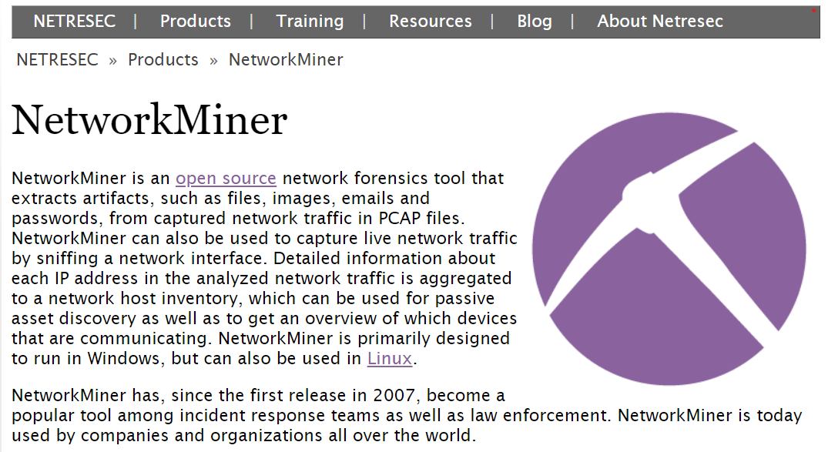
While setting up in NETRESEC choose network minor

Slide 9
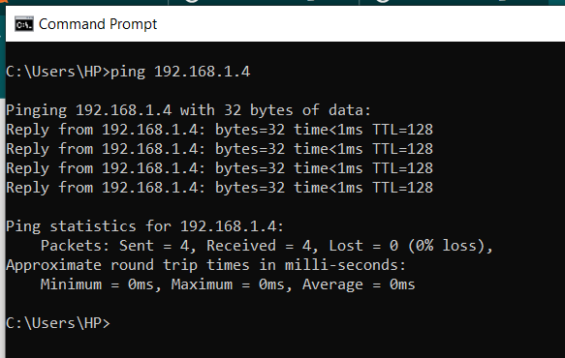
HOST 1: LOCAL PC
First, we will send packet to the host window machine of IP address shown in the picture using ping command, after confirming the packet send, we move to next part

Slide 10
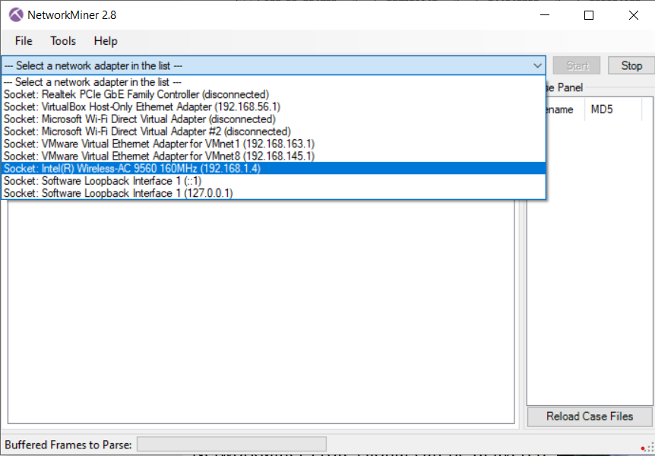
Run the network minor tool in run the administrative privileges and choose the desired adapter to capture the host and machines

Slide 11
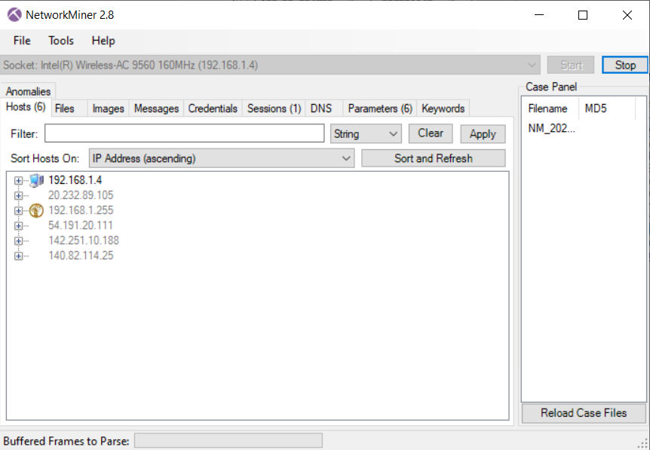
Most of the IP captured by the tool have a strong firewall. So, for analysis you can stop the firewall if host is known or choose the host with on local machine

Slide 12
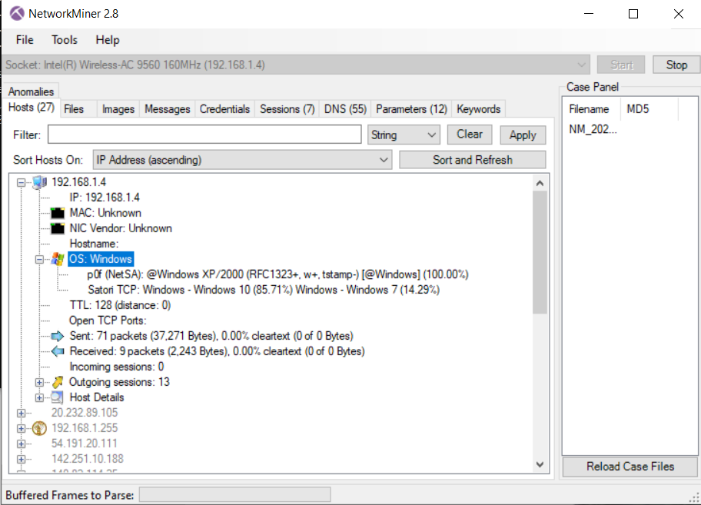
Select the local machine as host and click the IP to check for details capture of OS, sessions and etc.

Slide 13
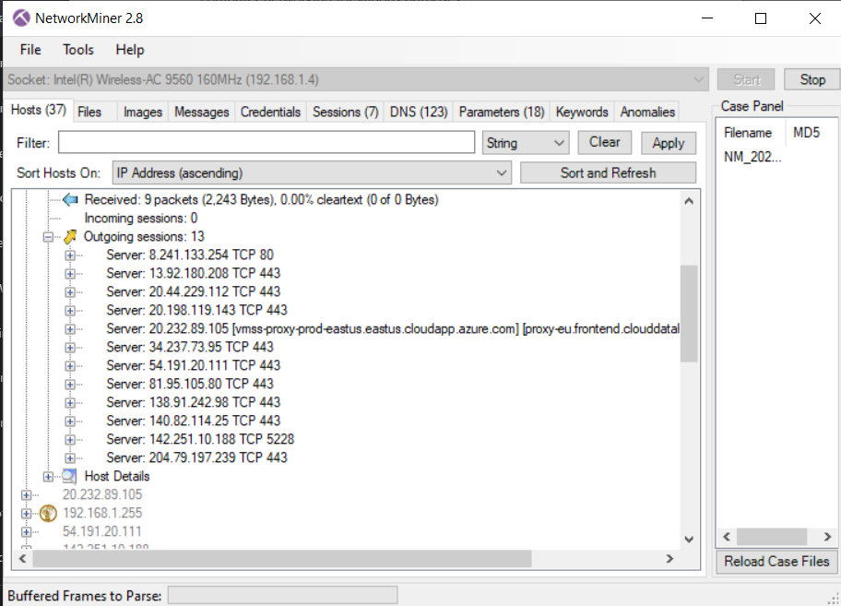
After opening various webpages local machine, check the total packet we send or received by using the internet and ping command we used earlier

Slide 14
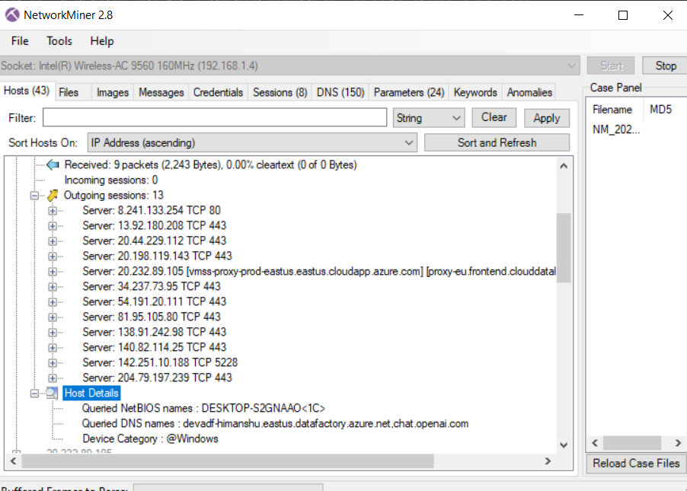
Cross- verify the outgoing sessions and incoming sessions and analyze the sessions and ports connected, usually it is TPC as we connected to webpages

Slide 15
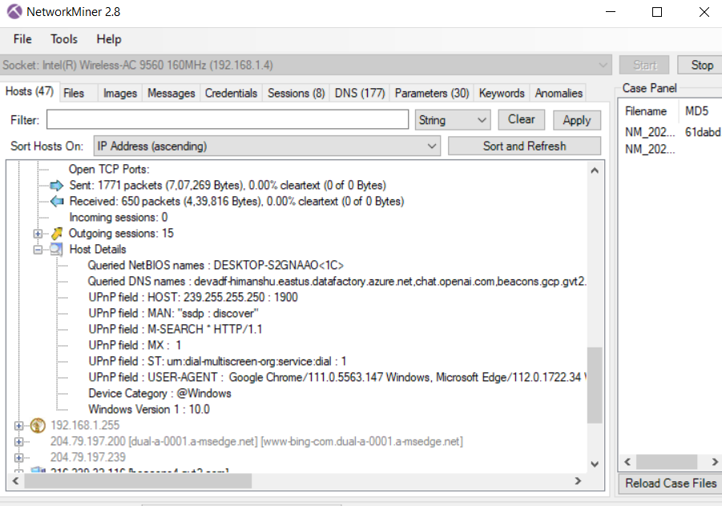
Check the host detail of selected host and cross verify the OS of the machine and see DNS query

Slide 16
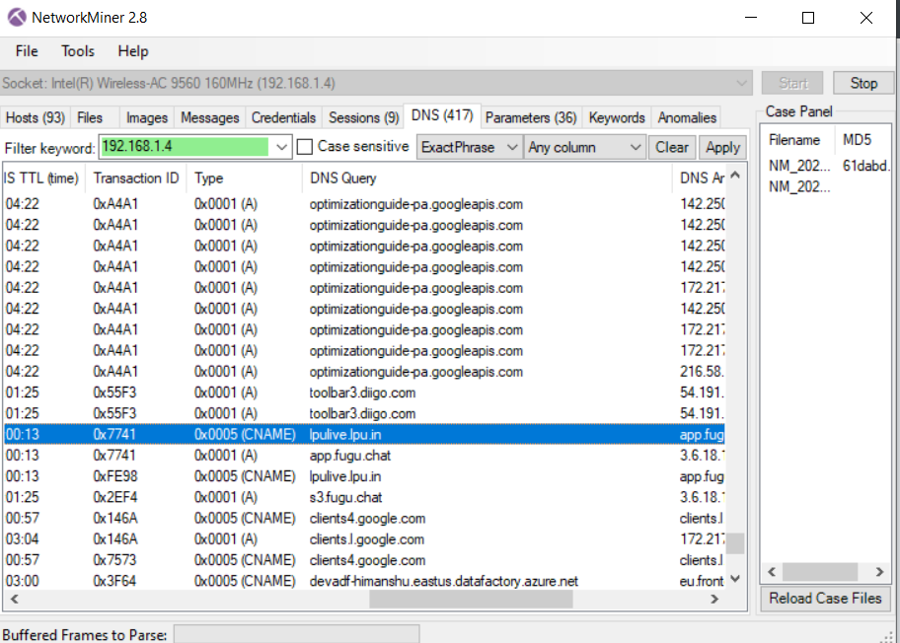
You can see all the DNS query by this host in the DNS section by selecting the desired IP of the target system and see which website we are using, here it is LPU LIVE

Slide 17
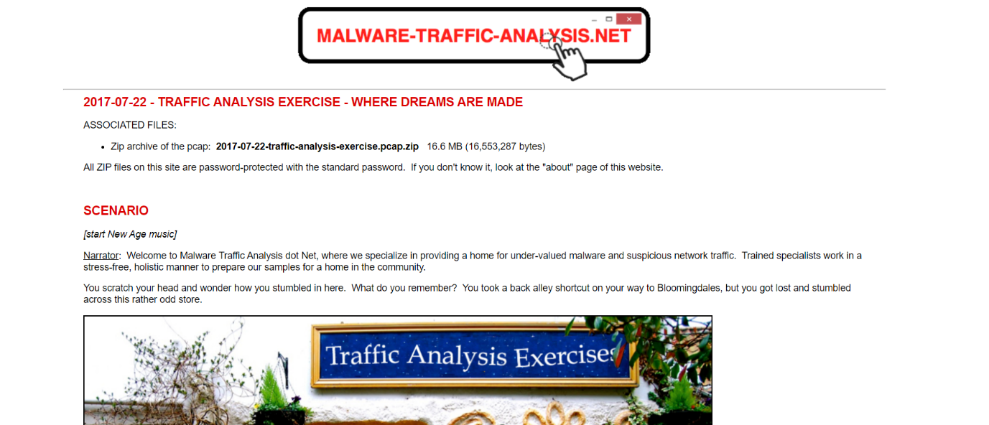
HOST 2: Trojan infected window machine in PCAP file
download the pcap file from malware traffic analysis.net of name where dream comes true. Unzip it using password INFECTED

Slide 18
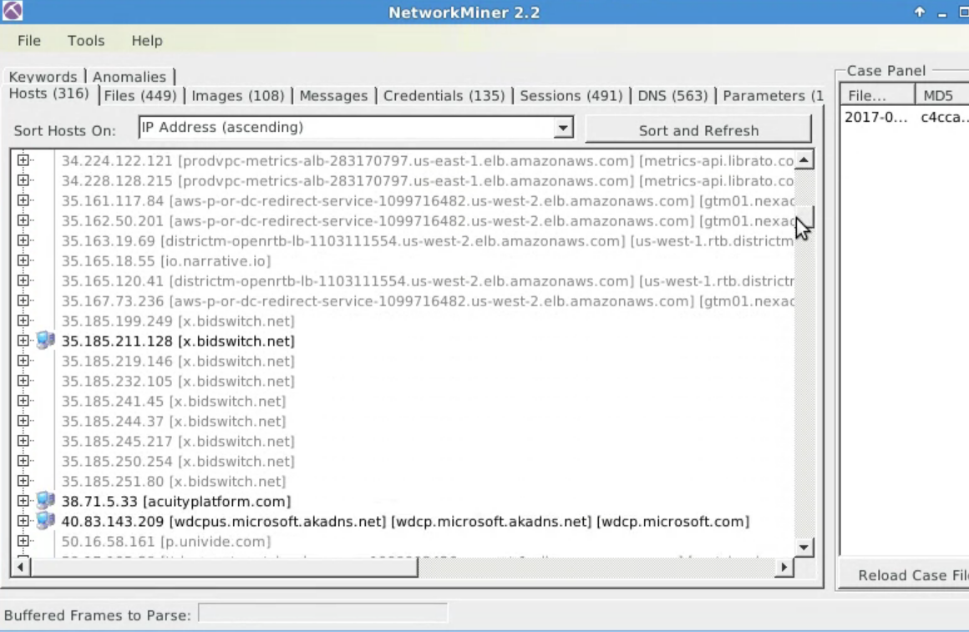
Drag and drop pcap file in network minor tools and u will see the host tab will get populated with various IP.

Slide 19
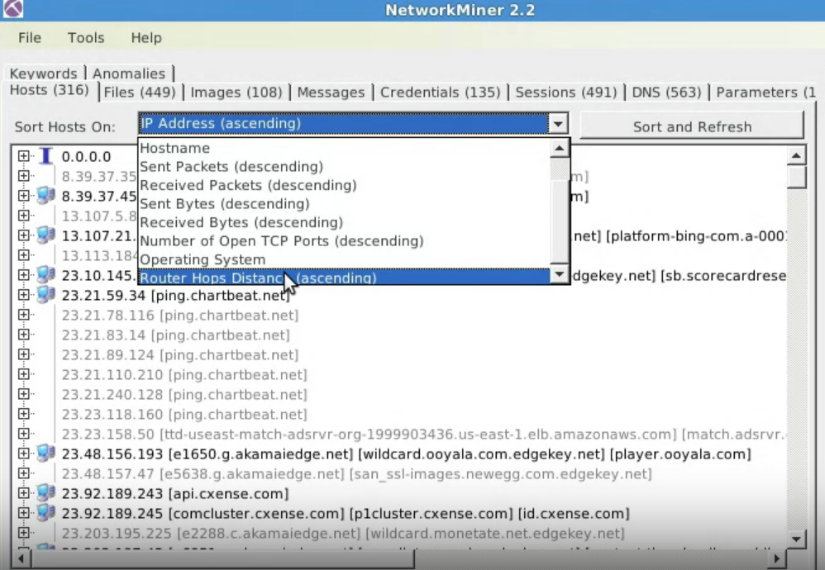
Because infected and target host will be from RFC1918 private network range, we can sort the ip address in router hops distance rather than in ascending order, so that we get host which are closest to sniffing point because there are machines which are several hops away i.e., they on same subnet on packet capturing device

Slide 20
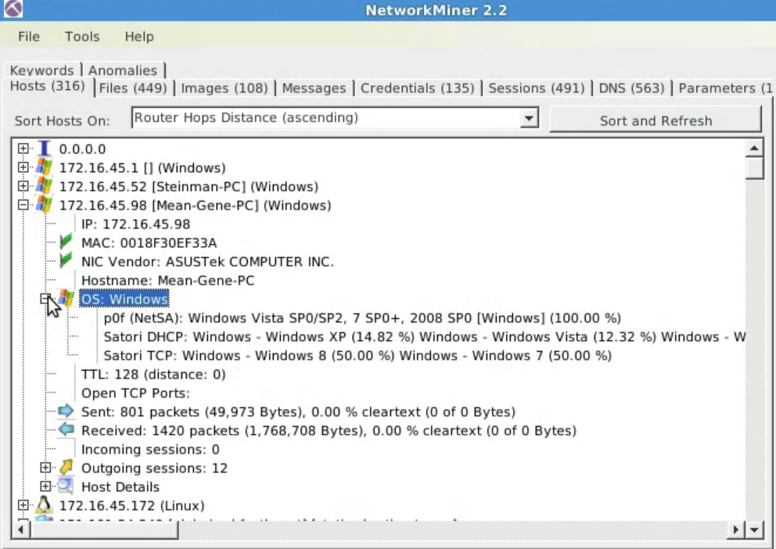
Check the first 5 IP address. Fist Ip will be from the client that request the ip address because they have sent the first tpc request from ip address before they assign ip address. Second on is the default gateway address to the other machine in same subnet

Slide 21
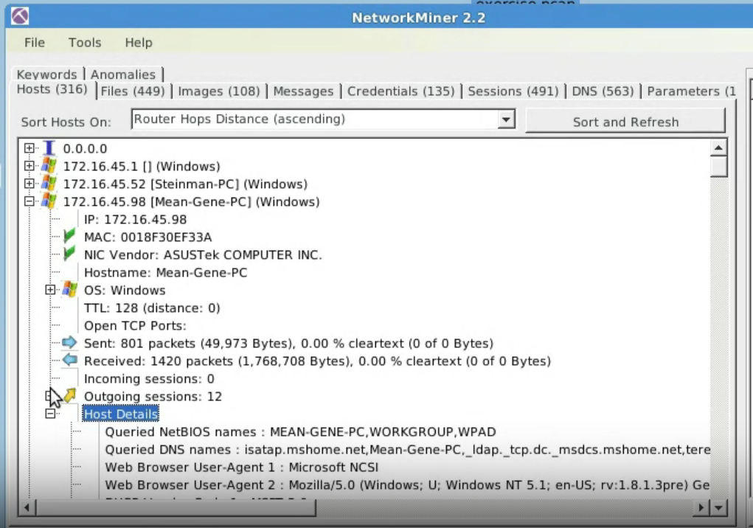
Third machine is the window machine and fourth will be also a window machine as we Expand the OS fingerprint. Seeing host detail tab, we will see it is WINDOW XP or window 5.1

Slide 22
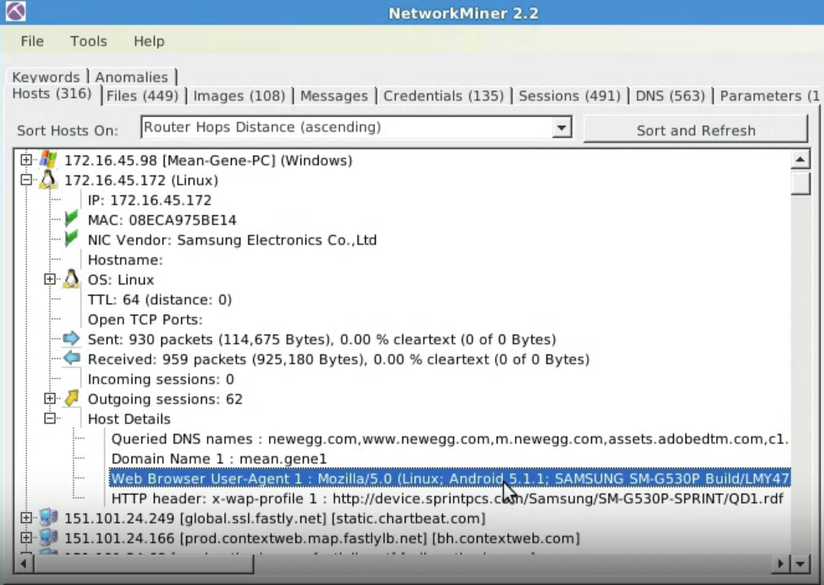
The next machine is the Linux machine based on OS fingerprint with NIC vendor is Samsung with host detail we can conclude it is Samsung galaxy phone

Slide 23
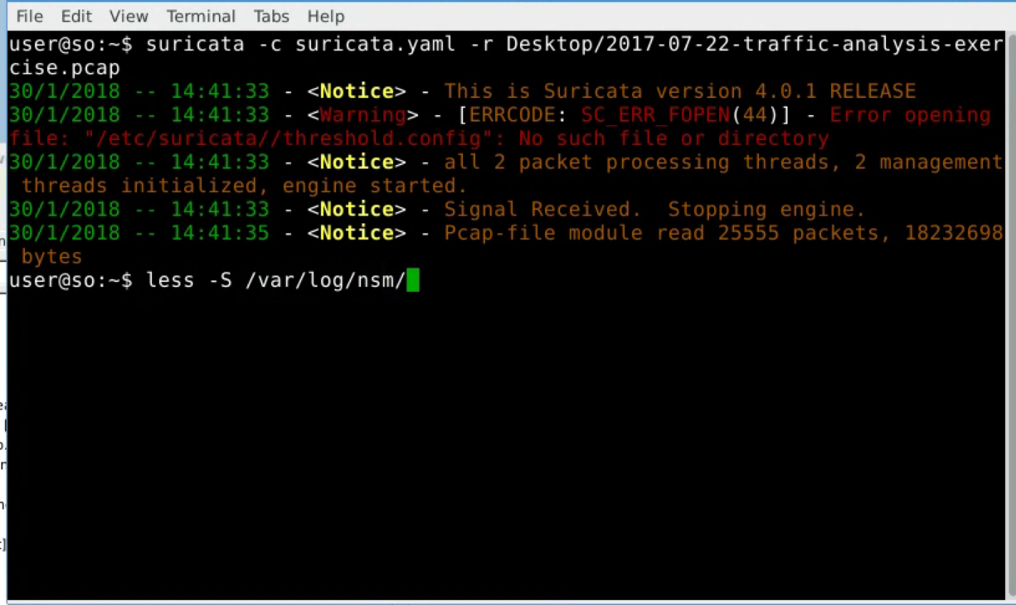
Install the SURFICATA tool and type the following command to search through the PCAP file to get any ideal alerts

Slide 24
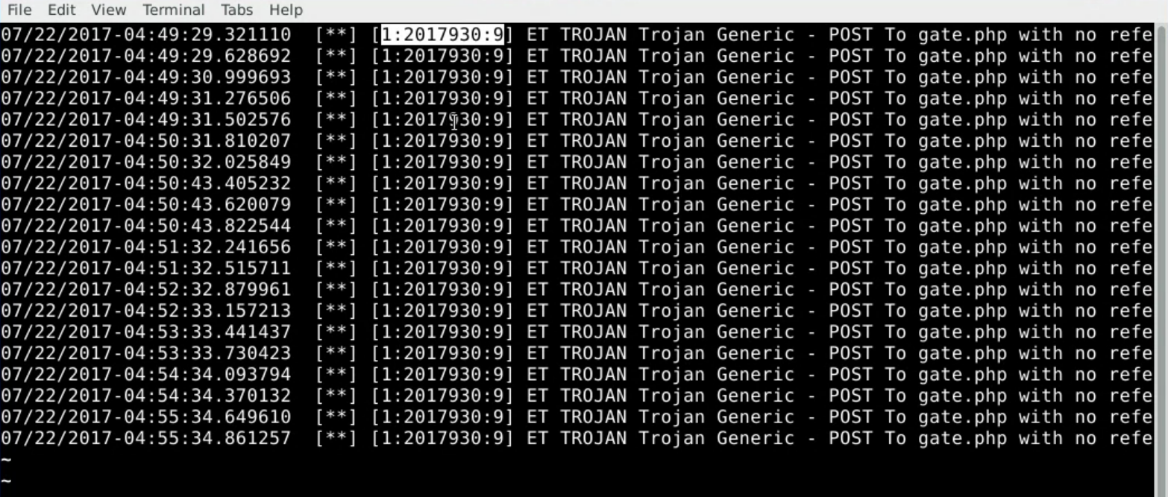
We can see multiple alerts from same signature triggering all the time i.e., 1:2017930:9 and altering the detection of generic trojan

Slide 25
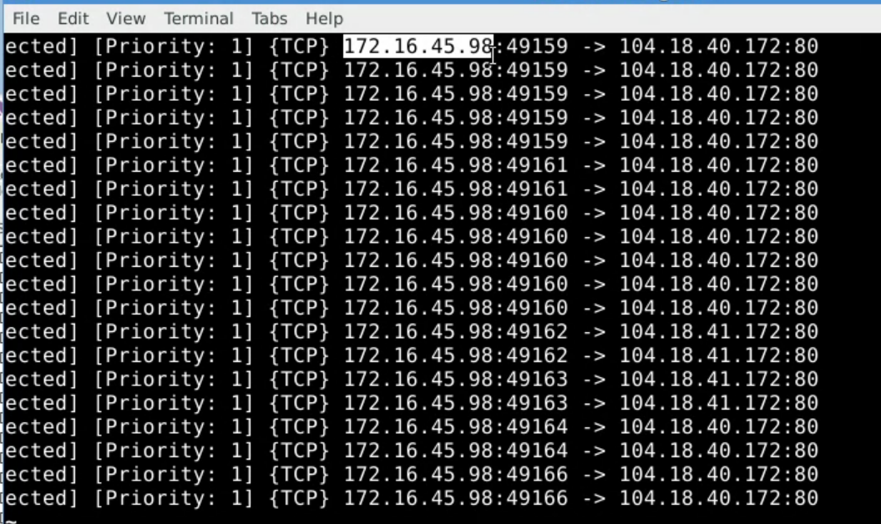
The ip address of machine where trojan is detected by SURFICATA tool is 172.16.45.98 i.e., 4th window target machine. SURFICATA alert is not specific it displays the probable machine to be infected. Thus, helps in further analysis on that host.

Slide 26
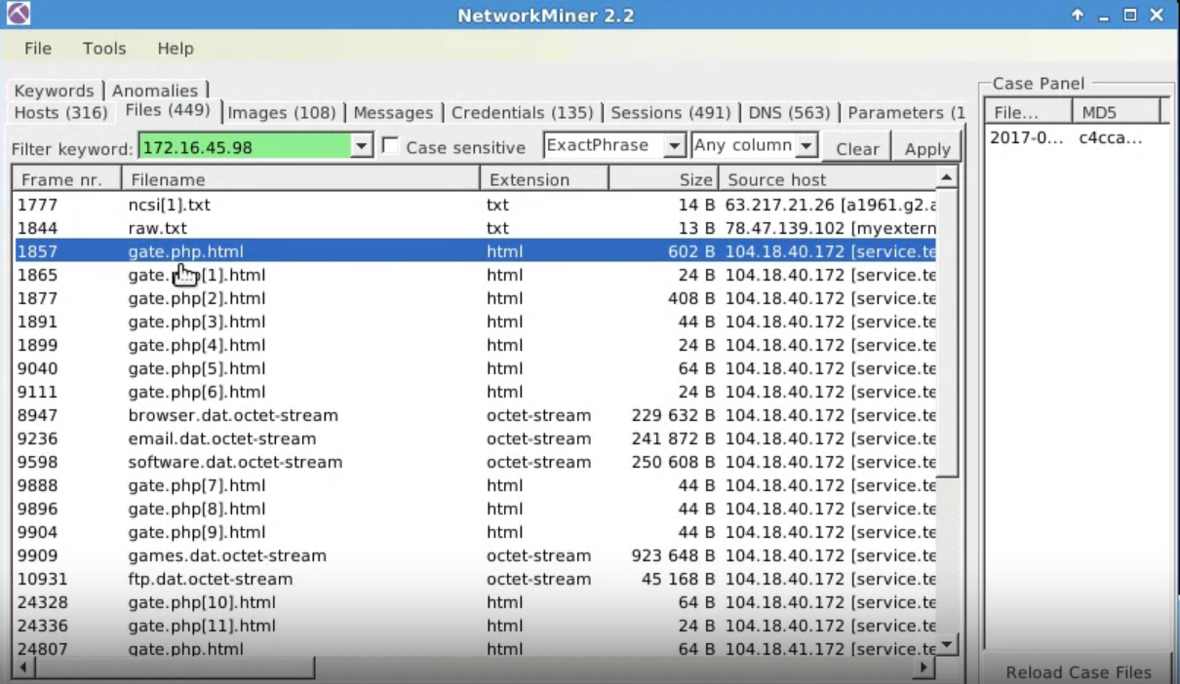
open file tab to see all the file uploaded and downloaded in this network, to see files/traffic from specific network search the file in search bar based on its ip. First file traffic for windows checking its network connectivity, second one is seen as external ip txt of this sandbox usually initiated by malware

Slide 27
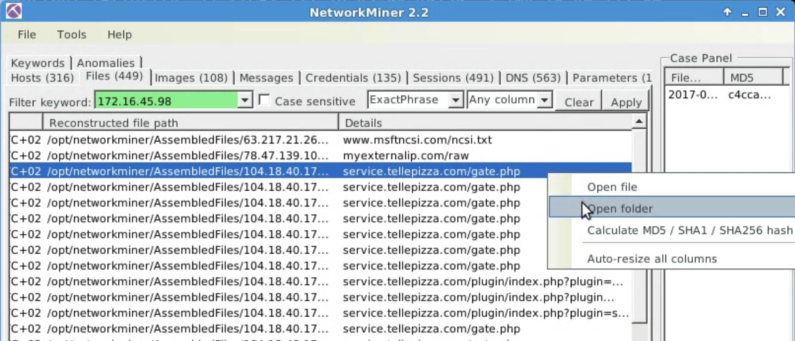
Open the folder for third request service.teelepizza.com and check all the folders downloaded

Slide 28
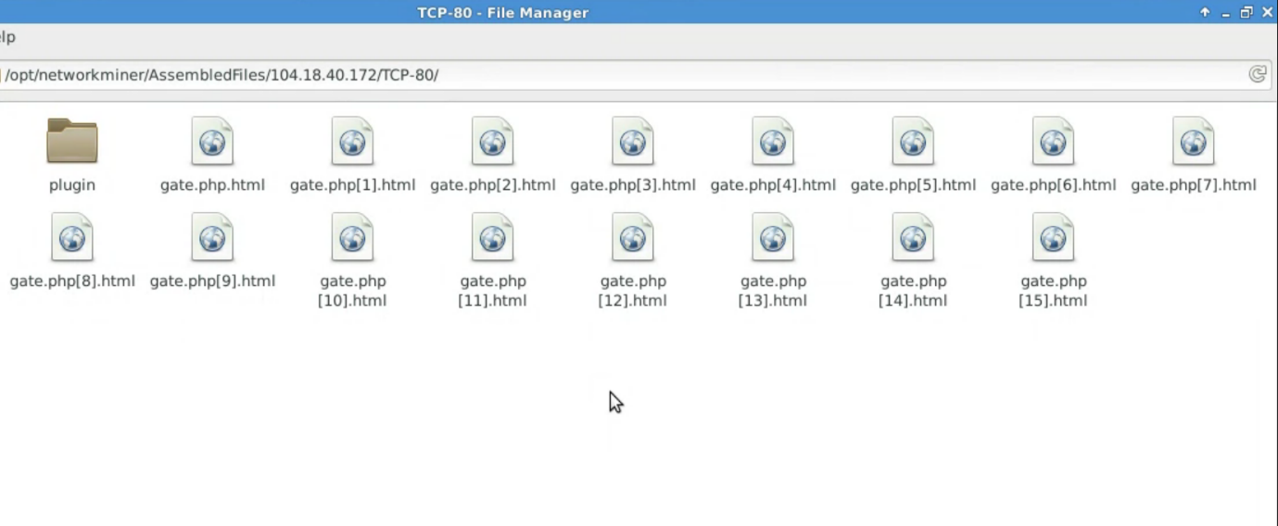
These are the file downloaded by this particular ip on port 80. We further analysis the file and its content to check for trojan. Like file gate.php.html have a certificate number which can be parse with OPENSSL. If search the certificate we will find that the certificate no will match in the zyklon http trojan with information of http user agent used by trojan which will match with the user agent of our host target machine i.e., BON ECHO (Firefox 2) confirming its infection with zyklon trojan

Slide 29
CONCLUSION
In conclusion, the implementation of a network miner tool to detect the operating system, sessions, and open ports through packet sniffing is a valuable technique for investigating network traffic. By analyzing the packets that are transmitted over the network, this tool can provide insights into the types of devices and systems that are present on the network, as well as any potential vulnerabilities that may exist. Furthermore, this tool can help identify potential security threats by detecting suspicious activity or unusual network behavior. Overall, the use of a network miner tool is an important aspect of network security and can help organizations better understand and protect their networks.

Slide 30

THANK YOU

